Slide 1
Welcome
To the Project Presentation

Slide 2
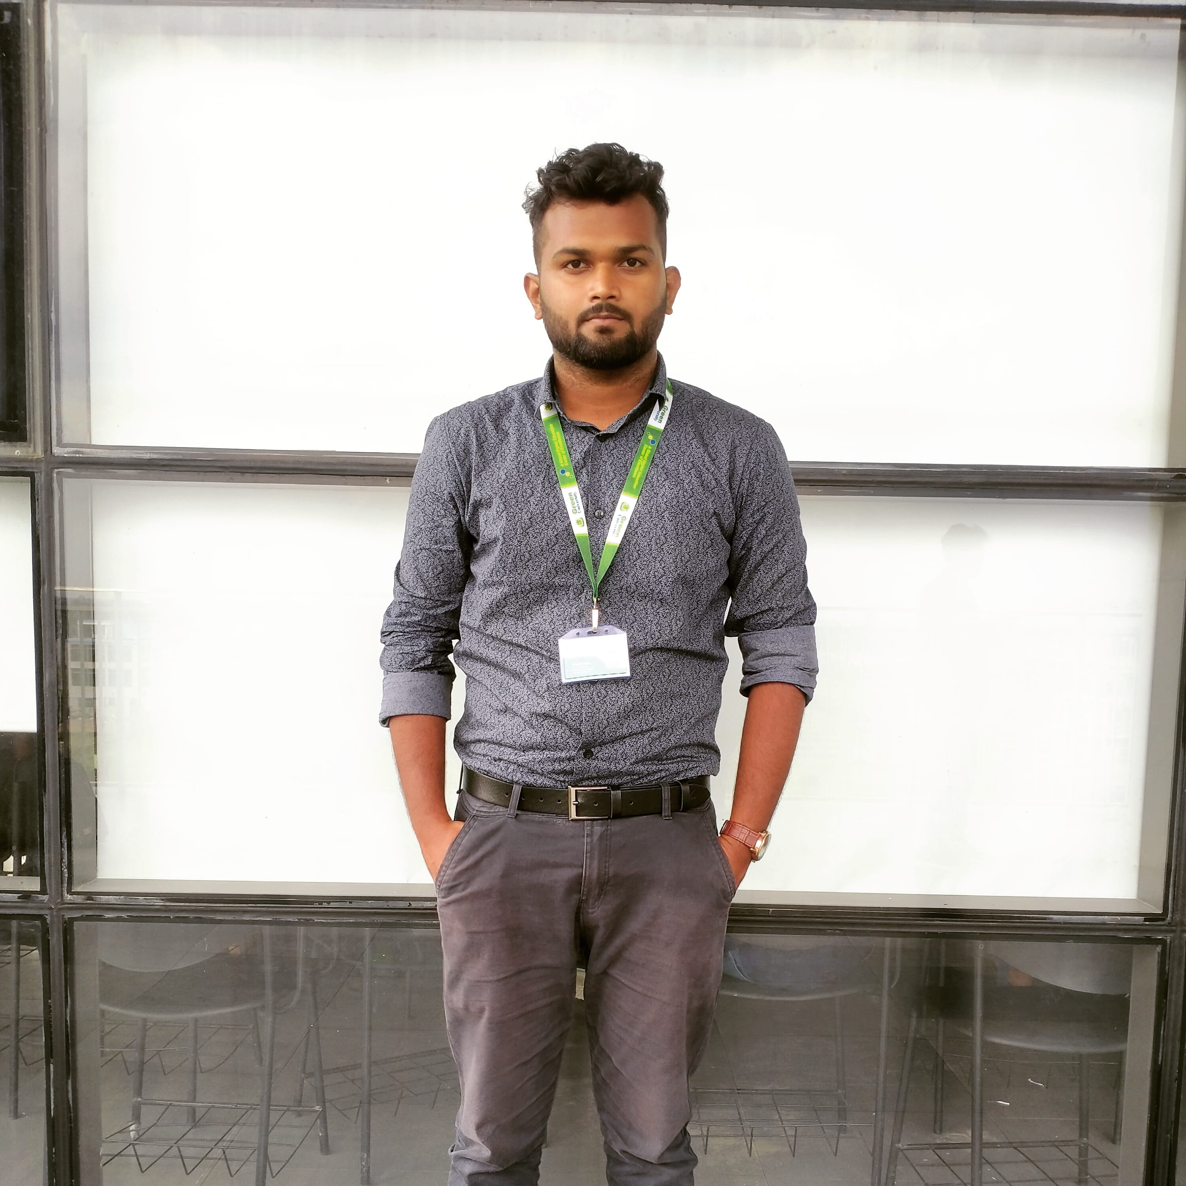

Team Members
Shakib Imtiaz
Jannatul Mayeda
202902008
Dept. of CSE, GUB
202902030
Dept.of CSE, GUB

Slide 3
Checking whether the data is secure or not

Slide 4
Agendas
Introduction
Description of the project
Functions and Algorithm
Implementation
Aim
Summery

Slide 5

Introduction

Slide 6
Description
Take some data as input
Check whether there is any error or not
Show the result
Make solution
Secure the data

Slide 7
Functions we have used
Parity_check()
CRC()
HummingCode()

Slide 8
Algorithm
Step1: Declare 3 variables named option1, option2, option3
Step2: Go to the next page if option1= 1
Step2: Go to the next page if option2= 1
Step3: if(option3=1) , paritycheck(), else if(option3=2), crc(), else if(option3=3), hummingcode(), else, return 0
Step 4: retutn 0

Slide 9
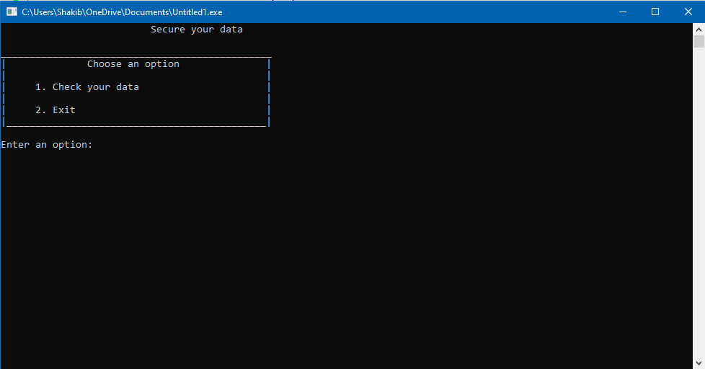
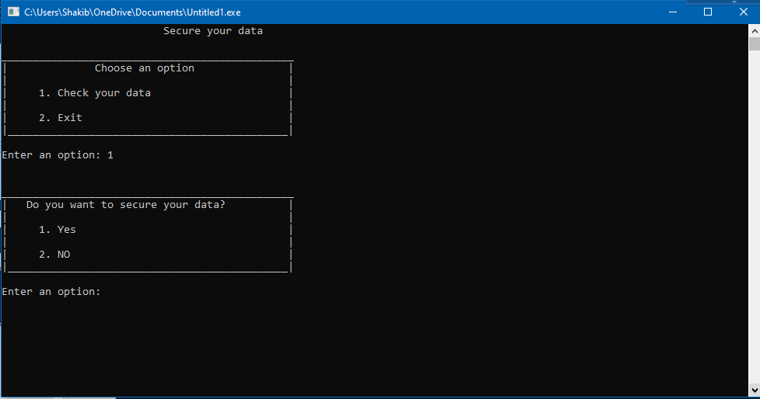
Implimentation

Slide 10
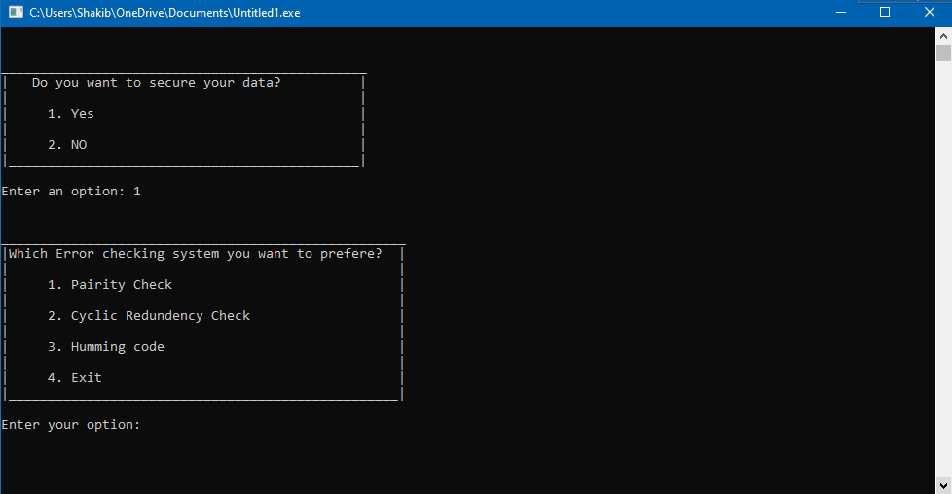
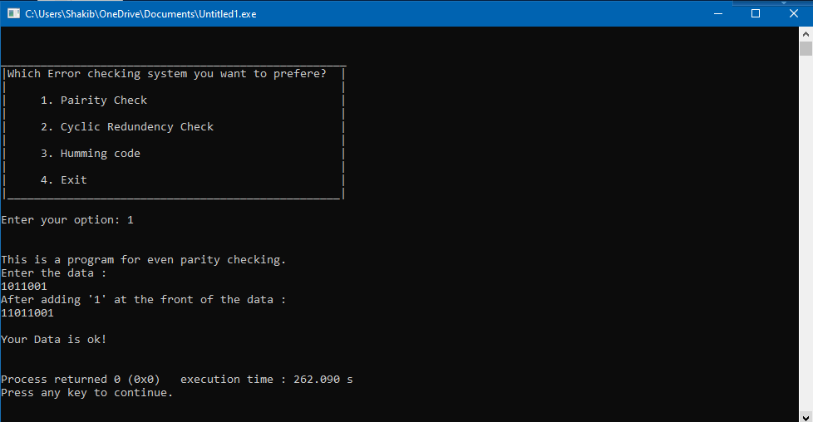

Slide 11


Aim of the project
11

Slide 12
Any Query?

Slide 13

Thank you

